Slide 1









SolSync
Kaylee Bae, Amy Huang, Valli Paladugu, Rudra Patel, Trishu Patel

Slide 2
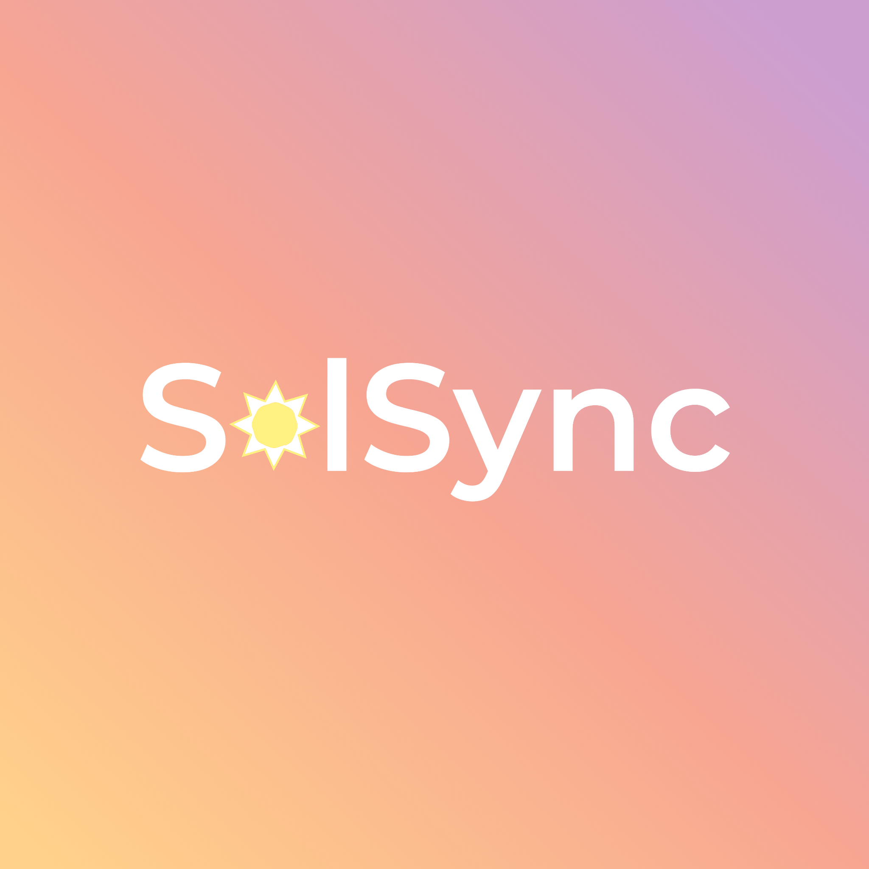
Overview
Certain practices correspond with sunrise and sunset
Hindu practice of Agnihotra
Keeping track of sunrise and sunset times can be difficult
SolSync is an iOS / Android app to track habits according to the sun

Slide 3
Major Features
Get sunrise and sunset times for today and tomorrow
Log in for more features
Enter personalized habits
Track habit completion over time
Sign up for emails reminding you to complete habits
Customize your profile

Slide 4
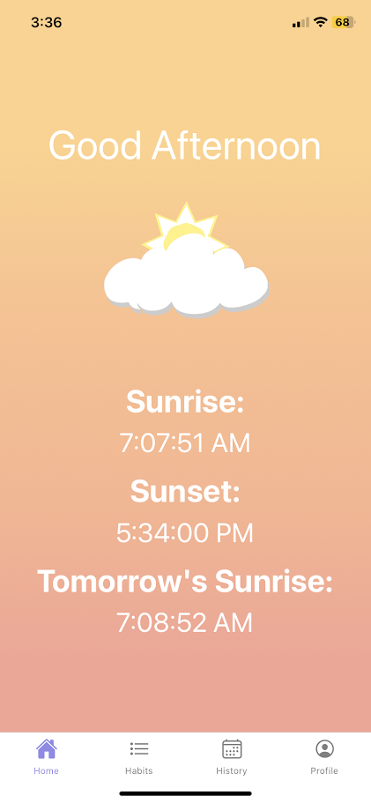
Sunrise and Sunset Times

Slide 5
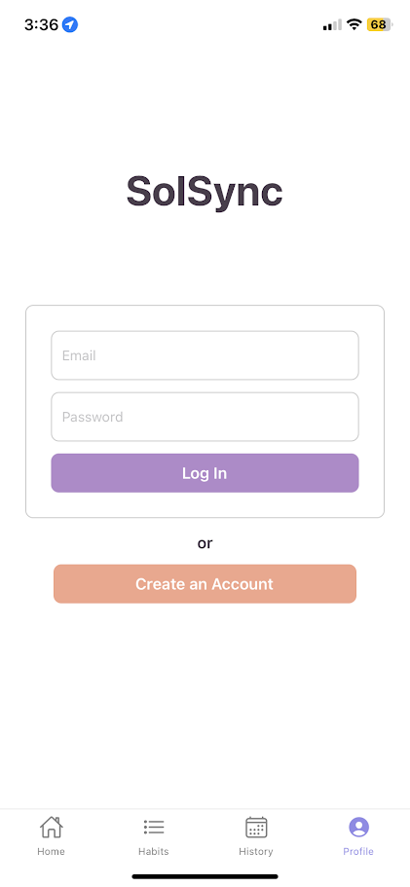
Log In

Slide 6
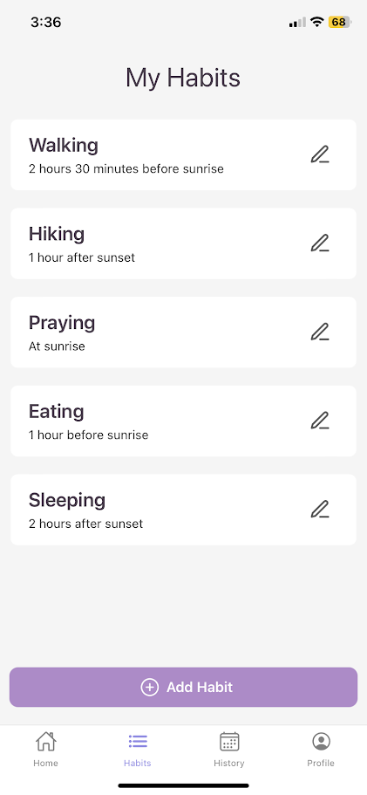
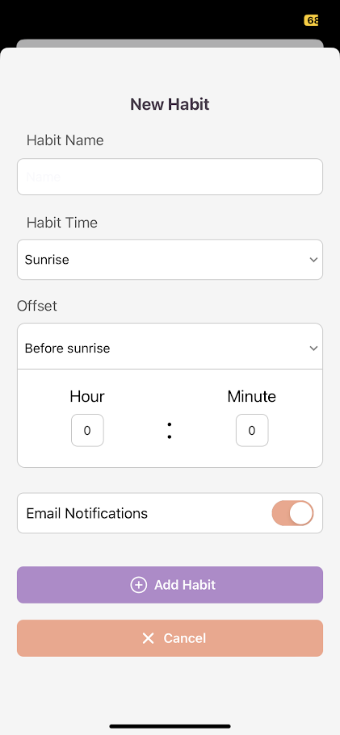
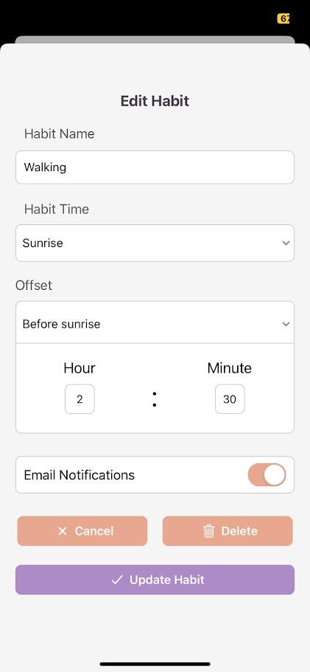
Track habits

Slide 7
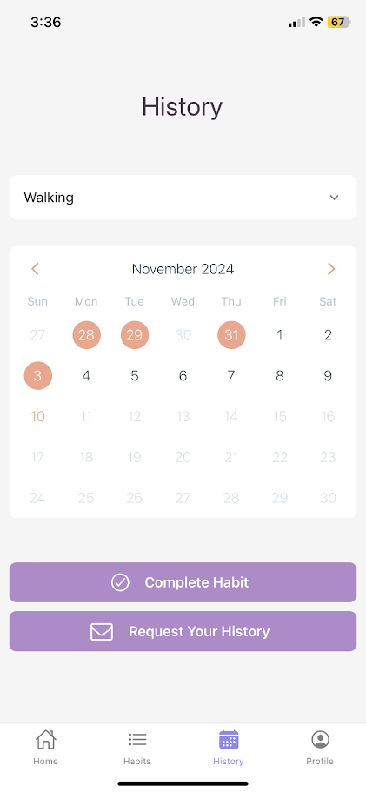
See completion history

Slide 8
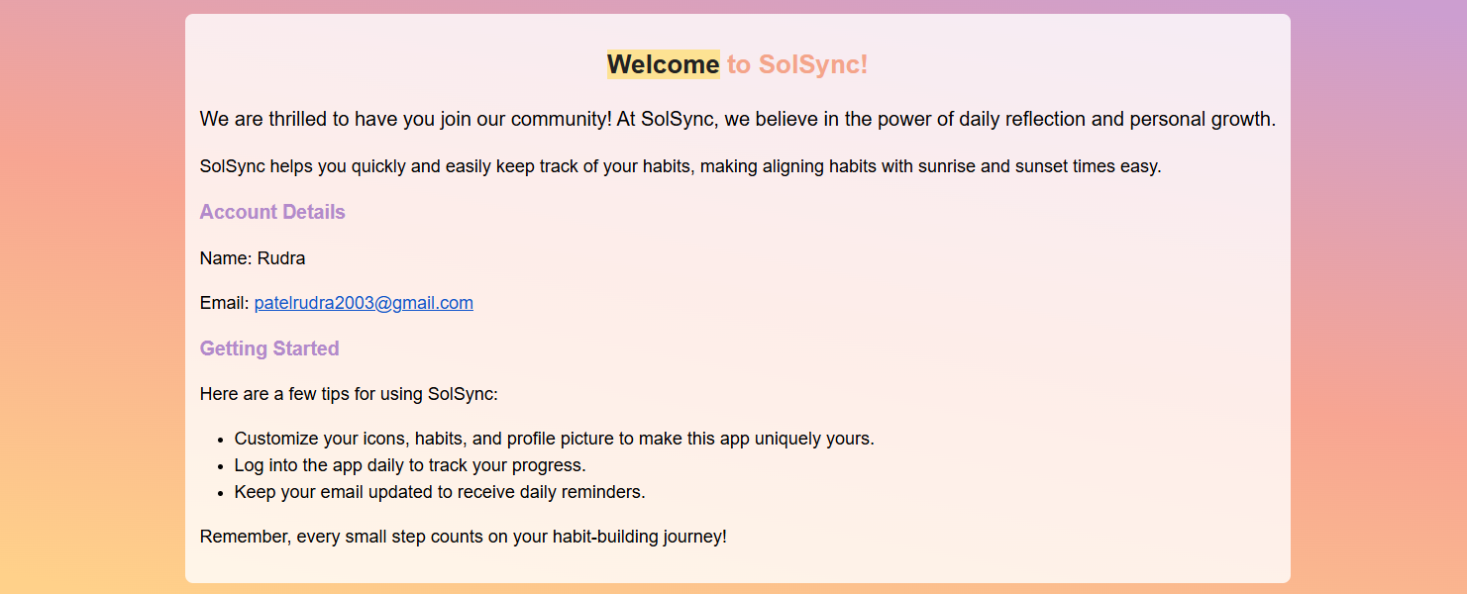
Sign up for emails

Slide 9
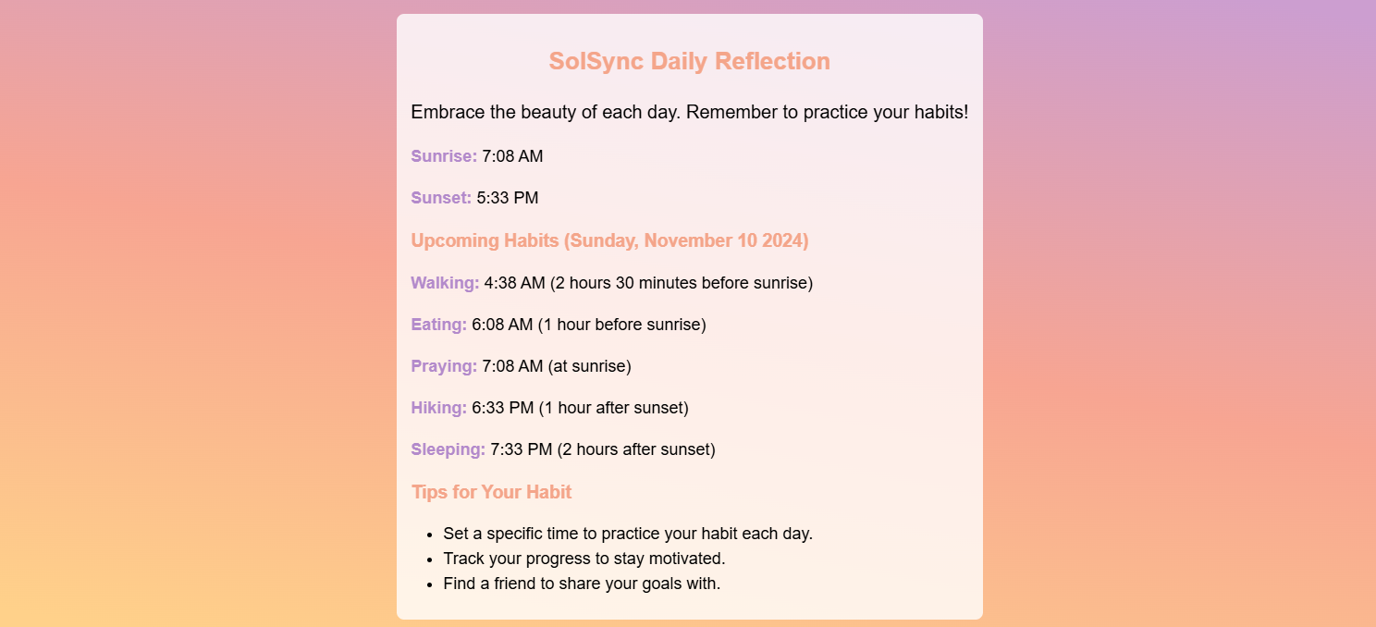

Slide 10
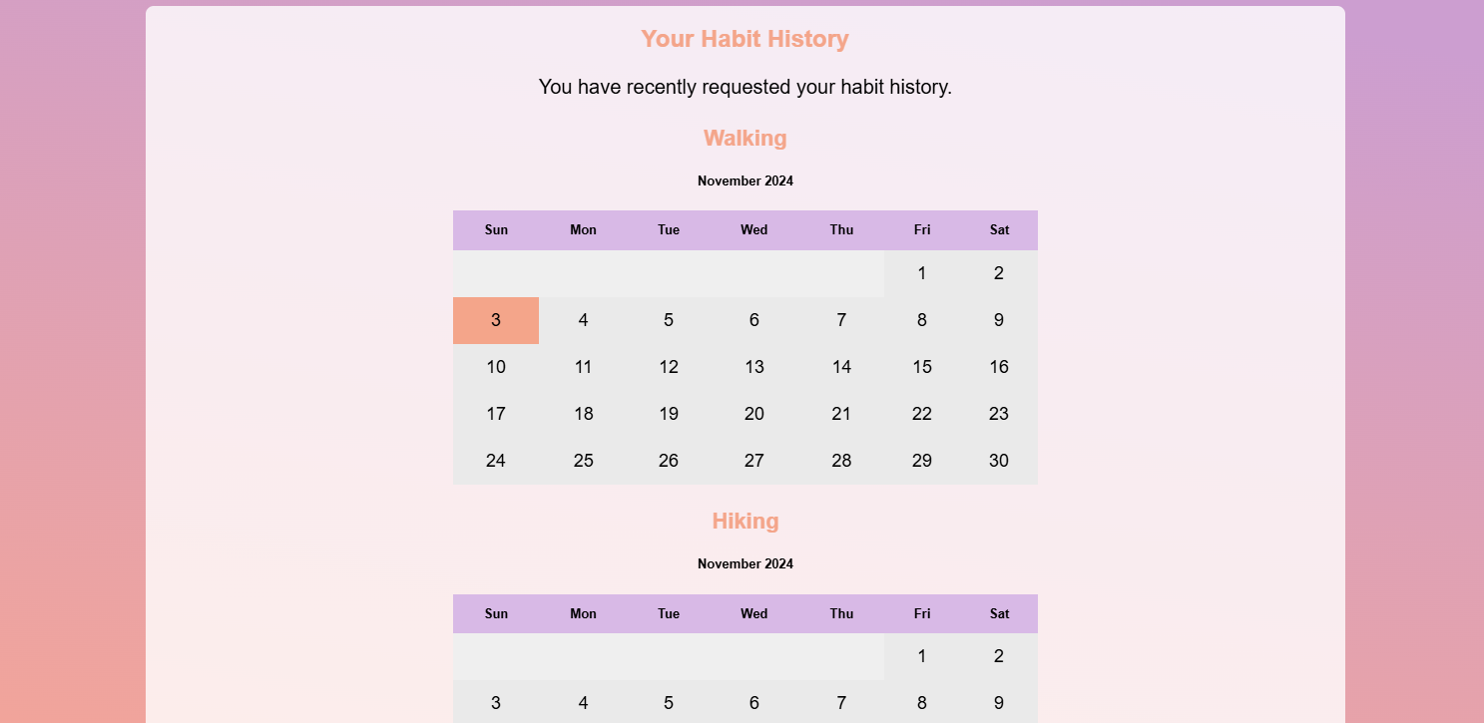

Slide 11
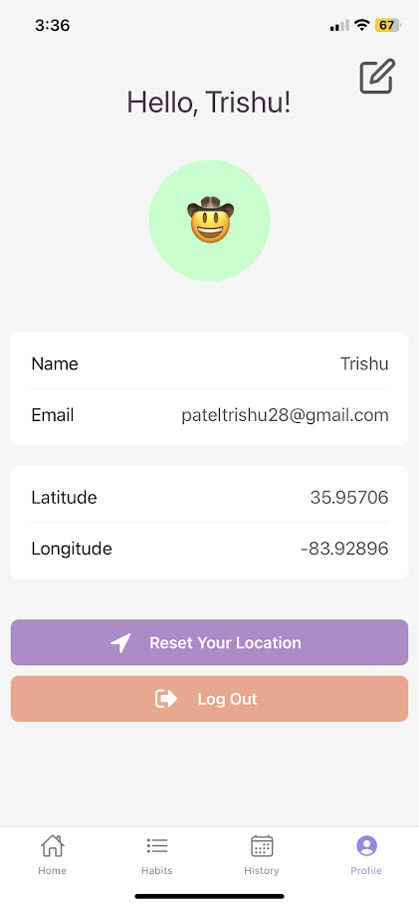
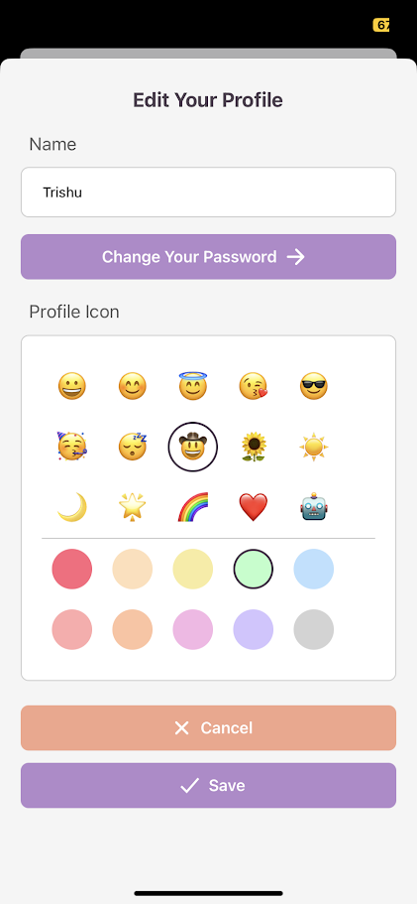
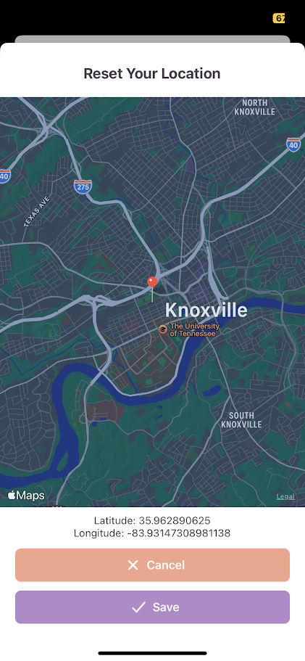
Customize Your Profile

Slide 12
Live Demo

